Slide 1



SMS Spam Filter Classifier
Building an Efficient Text Classification Model
by Kacem Benbrahim

Slide 2

Introduction
Overview:
The project focuses on creating a classifier to automatically distinguish between spam and legitimate (ham) messages

Slide 3

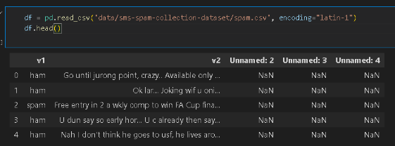
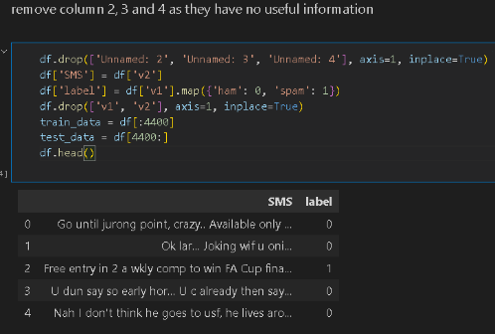
1-Project Components
1. Data Loading and Preprocessing:
Utilized pandas to load the SMS dataset
Removed unnecessary columns: df.drop(['Unnamed: 2', 'Unnamed: 3', 'Unnamed: 4'], axis=1, inplace=True)

Slide 4

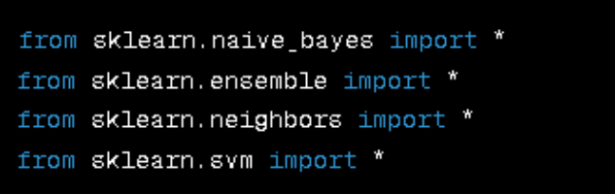
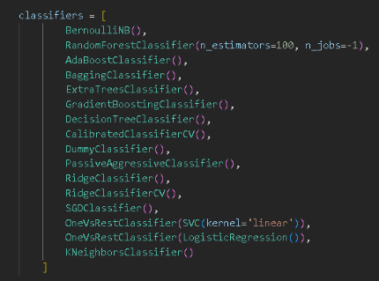
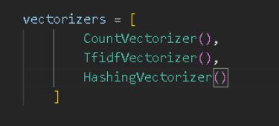
2-Model Selection
a-Machine Learning Models:
Imported classifiers from scikit-learn: from sklearn.naive_bayes import *, from sklearn.ensemble import *.
list of various classifiers we are going to use
list of various vectorizers we are going to use

Slide 5

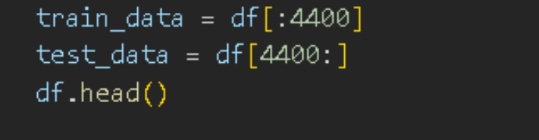
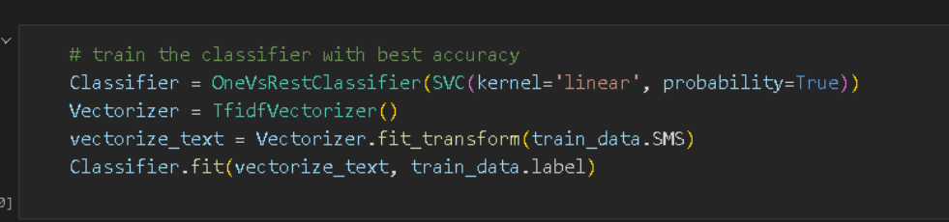
3-Model Training
a-Training the Classifier:
Split data into training and test sets.
b-Chose the best-performing classifier and trained it.

Slide 6

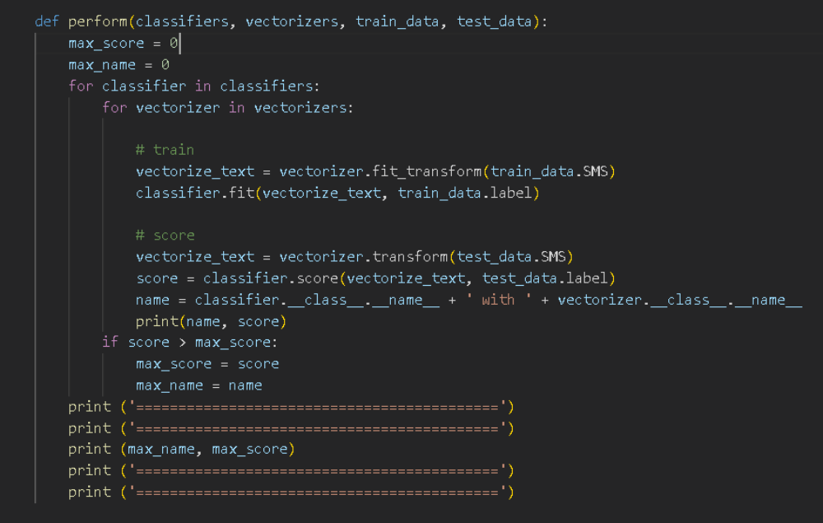
Model Evaluation
Performance Evaluation:
Created a function (perform) to evaluate various combinations of classifiers and vectorizers.

Slide 7

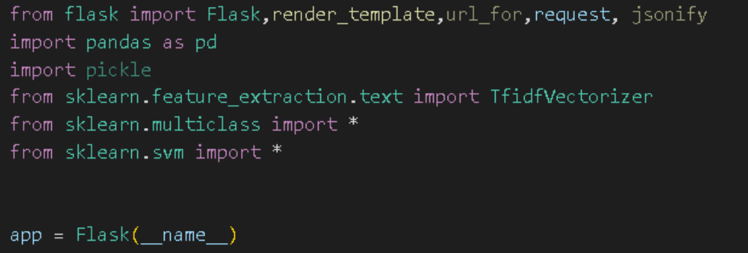
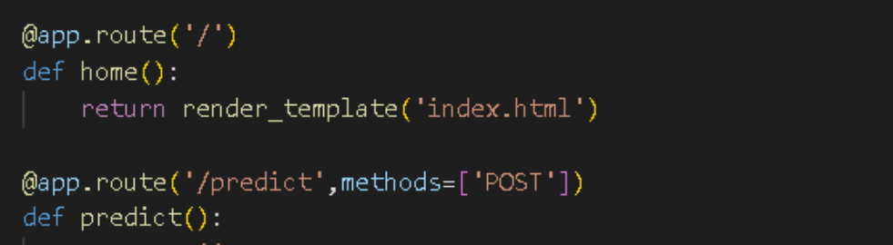
Flask Web Application
Building the Web App:
Created a Flask app with routes ('/' and '/predict').

Slide 8

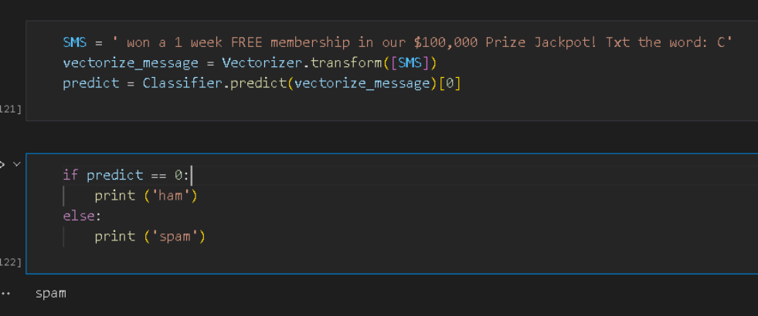
Results
Prediction Results:

Slide 9
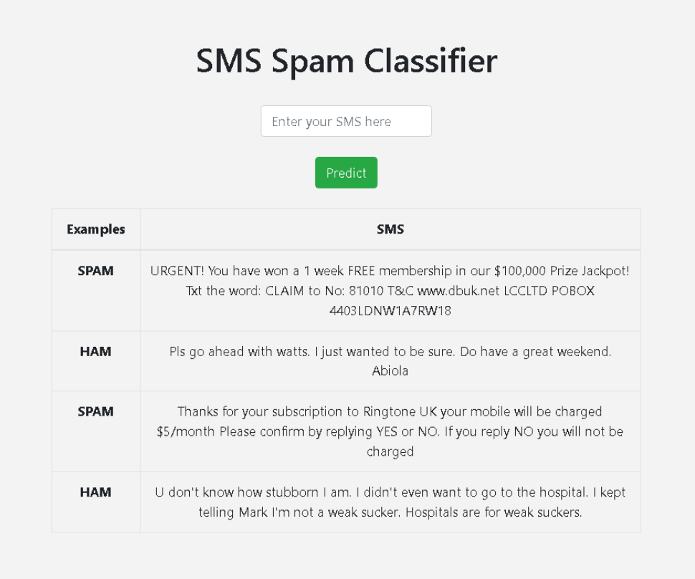
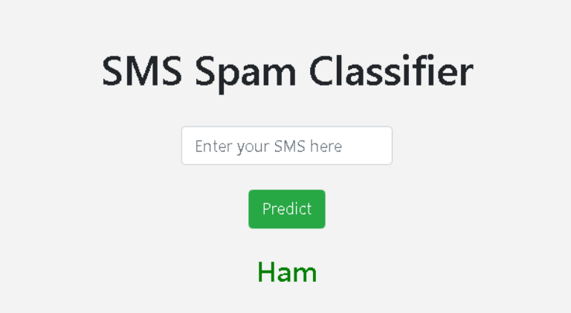
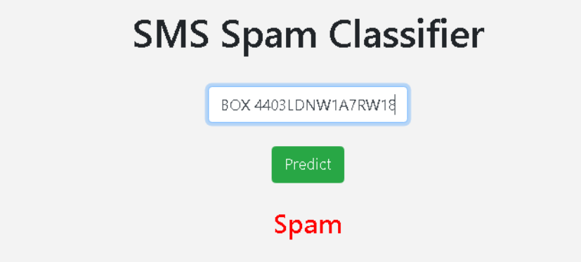
App Interface

Slide 10

Thank You!
Any questions or feedback are highly appreciated

